Slide 1
Electric Vehicle Fast-Charging Network
Matt Ott
Project Developer
MidAmerican Energy Company
HANDOUTS & PRESENTATONS ARE AVAILABLE THROUGH THE EVENT APP
AND AT WWW.IOWALEAGUE.ORG

Slide 2
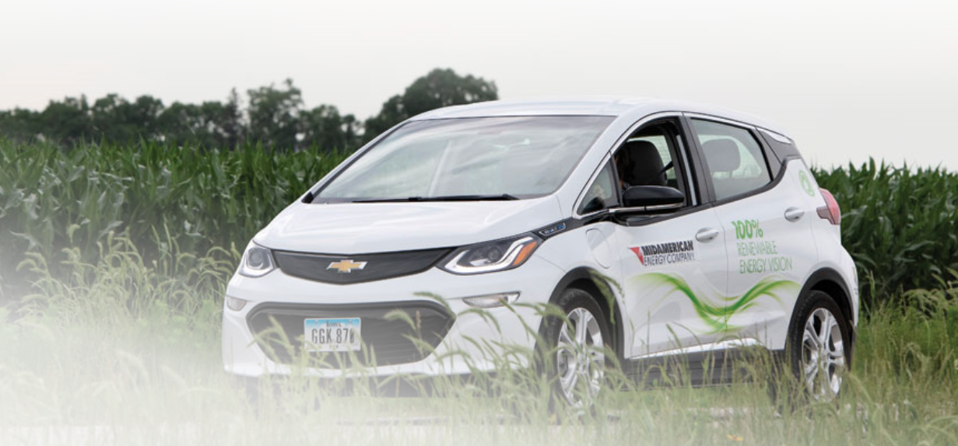
Electric Vehicle Overview
Introduction
EV Fundamentals
Opportunities for Our Customers
Barriers to EV Adoption
MidAmerican’s Role and Approach
Questions/Discussion

Slide 3
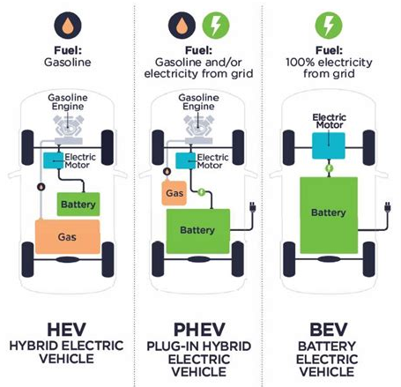
Electric Vehicle Types
Notes:
HEV – Toyota Prius
PHEV – Plug In Hybrid EV – Chevy Volt, Chrysler Pacifica
BEV – Battery EV – Teslas, Chevy Volts

Slide 4
Why Choose an Electric Vehicle?
EVs allow for a lower cost of ownership for our customers
Over 60% cheaper per mile for a BEV compared to an equitant gas vehicle
Scheduled maintenance for BEVs is also 40 percent cheaper

Slide 5
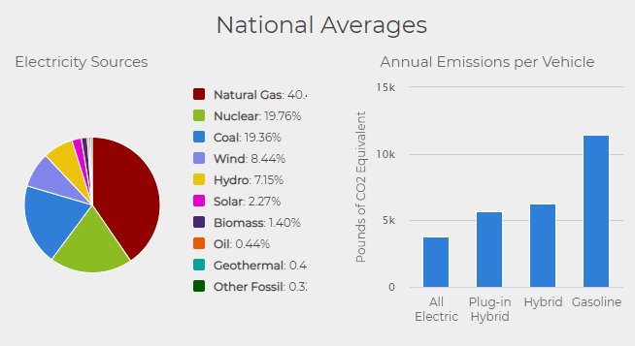
Why Choose an Electric Vehicle?
EVs allow for vehicle emission reductions and as we increase our renewable energy generation EVs will continue to be cleaner
In 2020, 83.6% of MidAmerican’s retail electric load was supplied by renewable energy
Source: U.S. Department of Energy
Notes:
In Iowa due to 57% of the electricity coming from wind, a BEV will produce over 1,000 less lbs of CO2 per vehicle
In 2019, CO₂ accounted for about 80 percent of all U.S. greenhouse gas emissions from human activities
The combustion of fossil fuels such as gasoline and diesel to transport people and goods was the largest source of CO₂ emissions in 2019, accounting for about 35 percent of total U.S. CO₂ emissions and 28 percent of total U.S. greenhouse gas

Slide 6
United States EV Adoption
Today there more than 1.7 million electric vehicles on U.S. roads
6,383 registered in the state of Iowa
Around 50 EV models are available today and nearly 130 models are expected by 2023; 18 out of the 20 largest OEMs have committed to increase the offer of EVs
7.79% of the vehicles sold in the U.S. during Q1 2021 were EVs; 80.56% year over year increase
Source: International Energy Agency
Notes:
23.4% increase in the number of EVS registered in Iowa from EOY 2020 till Q2 2021
Volvo will only sell electric cars from 2030;
General Motors plans to offer only electric LDVs by 2035;
Volkswagen aims for 50% electric car in the United States by 2030 and 100% by 2040; (VW, Audi, Porsche)
Stellantis aims for 35% electric cars sales in the United States. (Dodge, Fiat, Chrysler)

Slide 7
Iowa Market Share - Light-Duty Vehicles
Source: Alliance for Automotive Innovation (2021)
Notes:
Through April 2021

Slide 8
Barriers to EV Adoption
What’s holding back the large-scale adoption of EVs?
Public Knowledge and Perception - Consumers expect to be able to drive EVs in the same manner that they drive internal combustion engine (ICE) vehicles
Cost – Consumers expect a price point similar to that of ICE vehicles, and expect to pay the same or less as standard fuel
Range Anxiety – Consumers expect to be able to “fuel” their vehicle anywhere and anytime

Slide 9
MidAmerican’s Role and Approach
Public Knowledge and Perception Barrier
Partnerships - Develop strategic partnerships to establish roles and responsibilities in the advancement of electric vehicles and charging
Lead by Example - Utilize and expand MidAmerican’s EV fleet, install charging infrastructure to allow fleet travel across MidAmerican’s service territory, and implement employee charging program
Community Engagement - Support community discussions around the future of electrified transport
Notes:
Note the Midwest EV Coalition

Slide 10
MidAmerican’s Role and Approach
Cost Barrier
Residential Customer Incentive - $500 toward the purchase or lease of a new electric vehicle
Non-residential Customer Incentive - $1,500 toward the purchase of a qualifying level 2 charger for employee and/or public use (workplace, retail, commercial, etc)
Notes:
444 rebates given out to date; large increase in Q3 2021

Slide 11
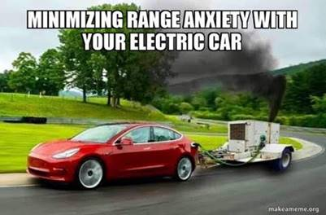
MidAmerican’s Role and Approach
Range Anxiety Barrier
Notes:
444 rebates given out to date; large increase in Q3 2021

Slide 12
Charging Equipment Types
Voltage 120V 1-Phase AC | Voltage 240V 1-Phase AC | Voltage 480V 3-Phase AC
Amps 8-16 Amps | Amps 12-80 Amps | Amps >120 Amps
Charging Capacity 1.4 to 1.9 kW | Charging Capacity 2.5 to 19.2 kW | Charging Capacity >50 kW
Charge Time 2-5 miles per hour | Charge Time 10-30 miles per hour | Charge Time 80% charge in 20-40 minutes
Notes:
Level 1 Cost – Free with vehicle, Level 2 – Appx. $1k (Bolt will now come with a dual voltage/level charger), Level 3 – 50 kW: $200k and 150 kW: $325k

Slide 13
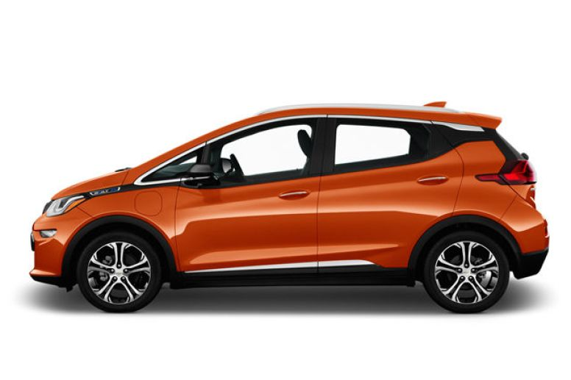
Time to Fully Charge 2021 Chevy Bolt Example
2021 Chevy Bolt
259 mile range – 66 kWh
*Typically charged to 80%

Slide 14
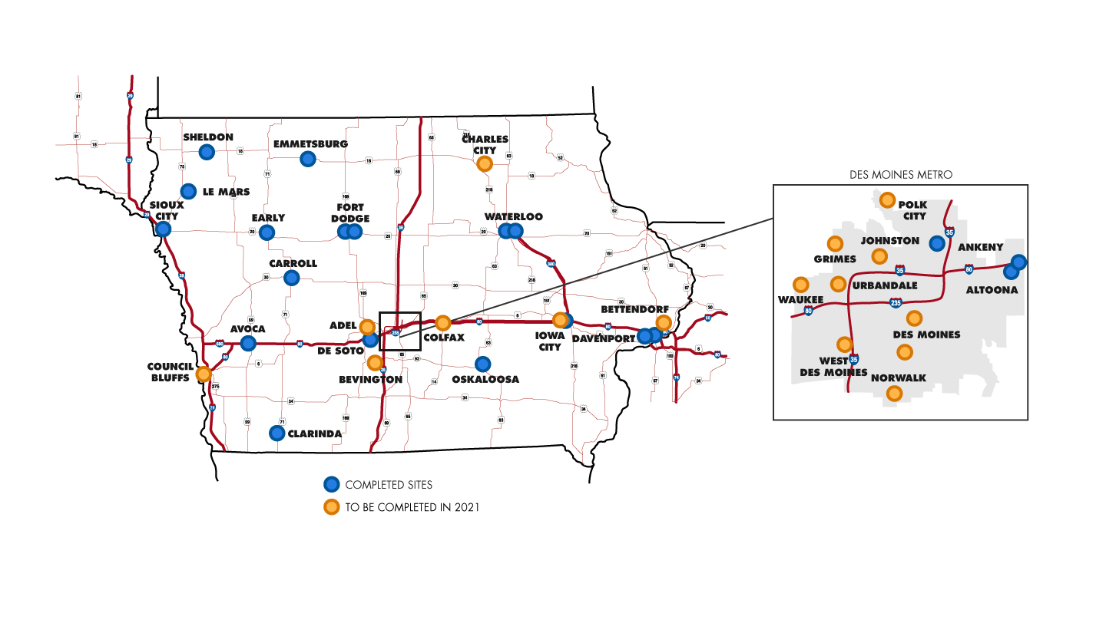
MidAmerican’s DC Fast-Charging Network
Targeting 50 locations throughout Iowa in MidAmerican’s service territory
2020 – 18 locations
2021 – 18 locations
2022 – 14 locations
Areas of focus
Major travel corridors
Rural and underserved areas
Charging capacity
50 kW chargers
150 kW chargers
Charging connectors
CCS Combo
CHAdeMO
Spaced roughly 50 miles apart to reduce range anxiety
MidAmerican will own and maintain the charging infrastructure
Notes:
Each site will be networked to provide MidAmerican Energy and the site host information on use patterns, electric usage, charger operating status, and diagnostic information
The site will be designed to accommodate expansion

Slide 15
DC Fast Charging Network Usage

Slide 16
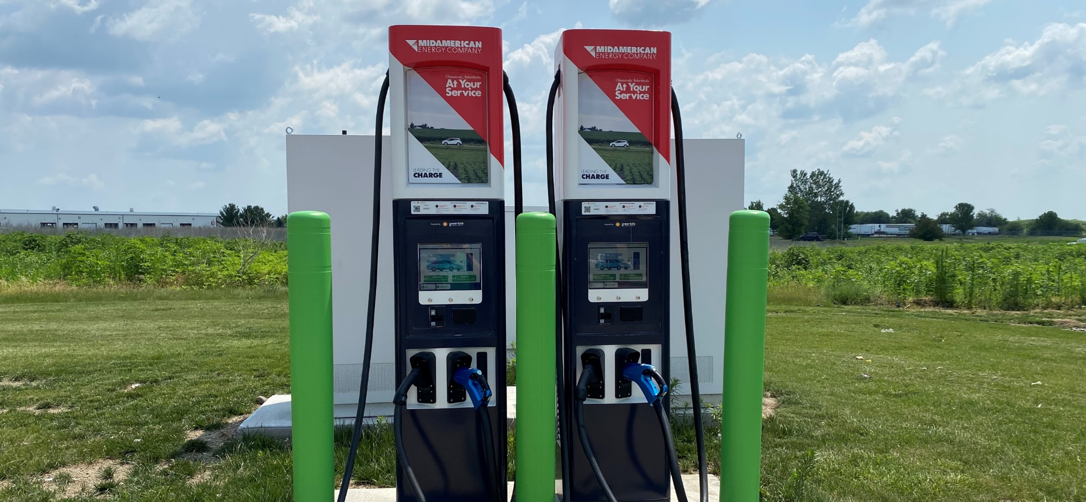
Leading the Charge
Matt Ott l matt.ott@midamerican.com l (515) 281-2203

