Slide 1
Political & Racial Speech – Impact on the Workplace
Aaron Hilligas
& Ann Smisek
September 16, 2021

Slide 2
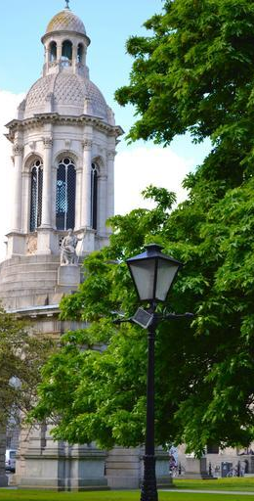
Overview
Ahlers & Cooney
For over 130 years,
Ahlers & Cooney has represented
educational institutions, municipalities,
and private entities.
Employment Law Practice Group
Our attorneys are always prepared to
respond to the constantly expanding array
of complex legal issues that surround the employer-employee relationship.
www.ahlerslaw.com
Notes:
We hope that, as participants in this Seminar, you are familiar with the Ahlers & Cooney law firm. If not, we are a long-standing Iowa firm, providing comprehensive legal services to government entities, educational institutions, and private companies throughout Iowa.

Slide 3
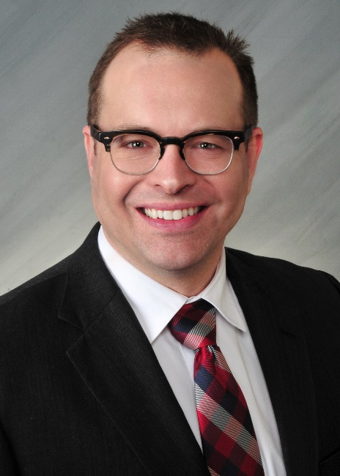
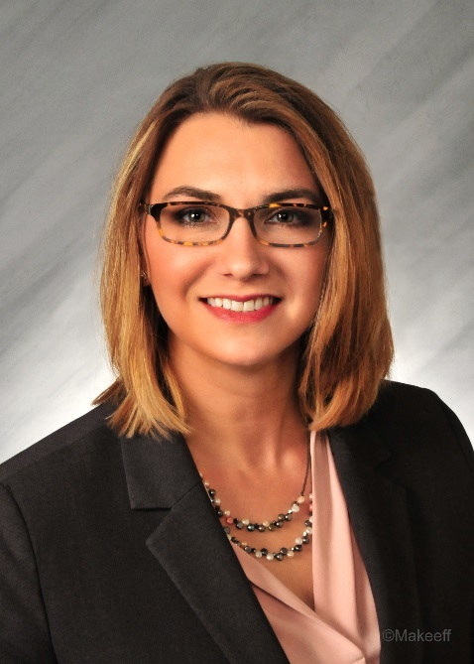
Presentation Team
Aaron
Hilligas
Ann Smisek

Slide 4
Disclaimer
This presentation is intended for general informational purposes only. Answers to legal questions about employees’ speech in and out of the workplace may involve analysis of both state and federal law and can vary greatly depending upon the specific facts in a given circumstance. Please consult an attorney about your specific situation.

Slide 5
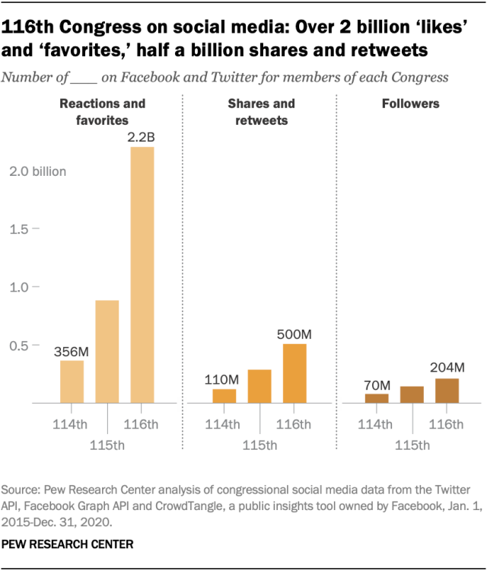
State of Political Engagement
Voting members of the 116th Congress collectively produced more than 2.2 million tweets and Facebook posts in 2019 and 2020.
Notes:
That means the median member of Congress produced more than 3,000 posts across their profiles on the two social media platforms during this span.”

Slide 6
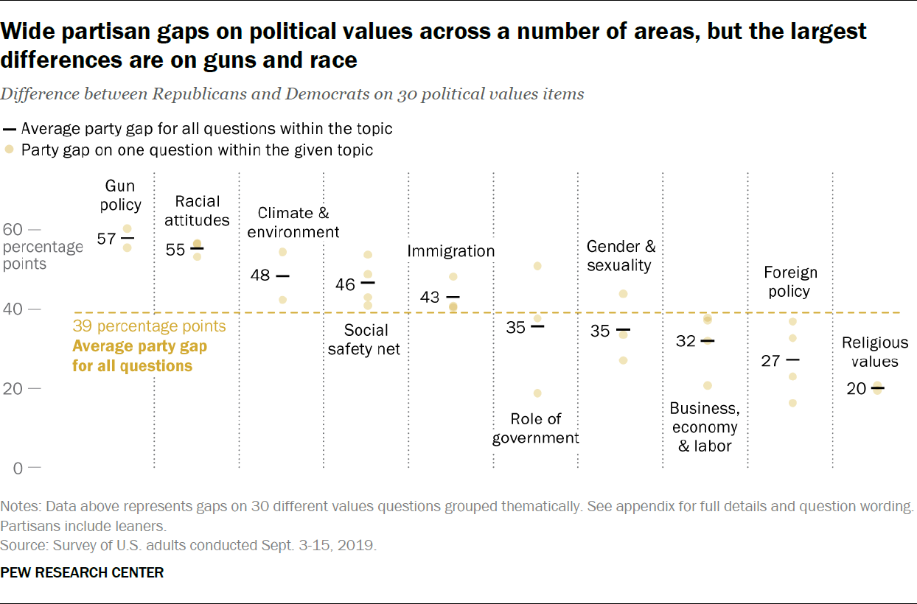
State of Political Engagement
Notes:
https://www.pewresearch.org/politics/2019/12/17/in-a-politically-polarized-era-sharp-divides-in-both-partisan-coalitions/

Slide 7
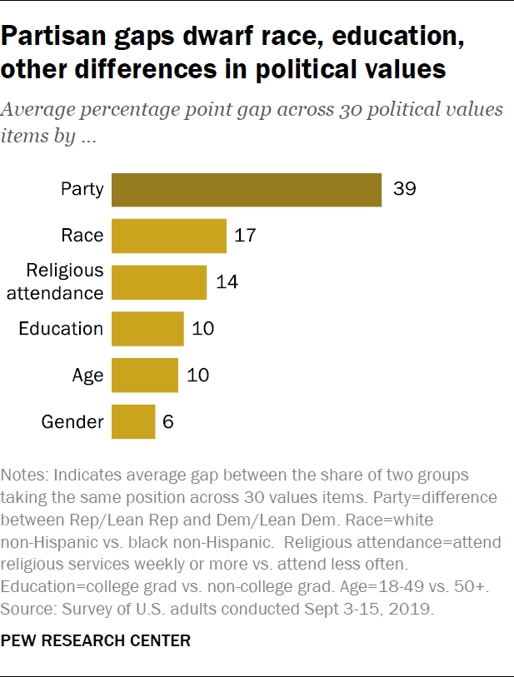
State of Political Engagement
Notes:
https://www.pewresearch.org/politics/2019/12/17/in-a-politically-polarized-era-sharp-divides-in-both-partisan-coalitions/

Slide 8
Constitutional Protections—
First Amendment
Employees of public employers have First Amendment protections
Employees’ speech is protected when the employee:
  Speaks as a citizen (as opposed to an employee and pursuant to official duties);
  Speaks on a matter of public concern/public interest (as opposed to personal concern);
  and
  The interests of the employee’s speech outweigh the interest of the employer in promoting the efficiency of the public services it provides.
Notes:
Congress shall make no law respecting an establishment of religion, or prohibiting the free exercise thereof; or abridging the freedom of speech, or of the press; or the right of the people peaceably to assemble, and to petition the Government for a redress of grievances.”
The “main thrust” of the speech must relate to a matter of public concern (Connick v. Myers)
Critical Question: Is the speech an ordinary part of the employee’s duties? If yes, it is not protected.
Private employers are generally allowed to prohibit/discipline employees from discussing politics while at work without violating the First Amendment

Slide 9
Constitutional Protections—
First Amendment
Matters of “public concern” are determined by the context, form, and content of the statement on a case-by-case basis
Factors of the balancing interest test include:
  Whether the statement impairs discipline by superiors or harmony among co-workers
  Has a detrimental impact on close working relationships for which personal loyalty and confidence are necessary
  Impedes the performance of the speaker's duties or interferes with the regular operation of the enterprise, or
  Undermines the mission of the employer
Notes:
Typically, “public concern” includes social and political concerns, as well as other concerns of community interest (legitimate news interest, general interest of value/concern to the public)
Balance the employees’ free speech rights with the government’s interest in avoiding disruption and maintaining workplace discipline. If the employer’s interest is stronger, then the speech can be regulated
Pickering test
Restrictions must be directed at speech that has the potential to affect the employer’s operations

Slide 10
Case Example
Bennett v. Metro. Gov't of Nashville & Davidson Cty., Tennessee, 977 F.3d 530, 533 (6th Cir. 2020)
A public employee used a racial slur when discussing the 2016 election on her public Facebook account on the night of the election
Her employer received multiple complaints from
co-workers
She was ultimately terminated because of the disruption her comment caused at work
Notes:
“Plaintiff Bennett began working for Metro's ECC as an Emergency Telecommunicator in 2001 and was employed there for 16 years. Her role was to field emergency calls, and she was also certified in emergency medical dispatch and emergency fire dispatch.”
“On the evening of November 8, 2016—Election Day—Bennett anxiously awaited the results of the Presidential election, hoping for a win by the candidate she supported, Donald Trump. She stayed up watching the results until about 3:00 a.m. on November 9, when the electoral votes for Trump reached 270. At that time, she made a Facebook post from her public-facing profile of an image of the electoral map revealing Trump as the winner. Shortly thereafter, before Bennett went to bed, she received a notification that Mohamed Aboulmaouahib—a man she did not know—commented on her post, writing that “Redneck states vote[d] for Trump, niggaz and latinos states vot[ed] for hillary.” She replied: “Thank god we have more America loving rednecks. Red spread across all America. *534 Even niggaz and latinos voted for trump too!””
Bennett not only identified herself as a Metro employee in her Facebook profile, but also as an ECC employee and a Metro Police Department employee
Donegan was concerned by Bennett's lack of remorse about her language and by her failure to acknowledge that it was an issue. It was only when Sanschargrin said it was possible the situation could result in some form of corrective or disciplinary action that Bennett changed her tune. Bennett asked how to fix the situation and offered to apologize to employees, but she declined Donegan's offer to issue an apology at roll call that morning. In the end, Donegan decided to place Bennett on paid administrative leave for a week or two to give management time to investigate the matter and allow the “uproar that had started to settle down.”

Slide 11
Case Example
The court found that the employee’s speech did not garner the “high level of protection” because the focus was on the use of a racial slur rather than her position about the election.
As such, the balancing test required less of a showing of disruption.
The record showed her comments caused “nonstop” conversation for days and the tension nearly a month, prompting the employer to hire a counselor for the office. The employer was not confident the employees could all work together.
Notes:
Pickering analysis: Court found the statement impaired harmony among co-workers, had detrimental impact on working relationships, close call/unlikely to interfere with regular operation of the enterprise (aka she could still do her job), and did detract from the mission of the employer because of the statement’s impact on public perception
“Had Bennett's profile been private, or had it not indicated that she worked for Metro, Metro's argument for terminating Bennett would not be as strong.”

Slide 12
Constitutional Protections—
First Amendment
Complete an analysis of protected speech before disciplining
  When did the speech occur?
    During work → Is there an existing policy violation?
    Outside of work → Balancing analysis
Notes:
Consider allowing employee to voluntarily take down posts
Remember to consider other applicable laws
You can avoid First Amendment analysis issues if there are other ways to regulate the behavior: time/place/manner regulations, other work behavior policies that don’t deal with content (i.e. posting on personal social media accounts while at work)

Slide 13
Recap: Non-protected Employee Speech
Personal gripes
Personal matters
Disruptive speech
Official duty speech

Slide 14
Analytical Framework
Step One
Is employee speaking as a private citizen or in their position as an employee?
Step Two
Are they speaking on a matter of public or private concern?
Step Three
Balance the interest of the employee’s speech against the employer’s interest in maintaining their workplace

Slide 15
Analytical Framework
 | Matter of Public Concern | Matter of Private Concern
Speaking as employee in official duties | Not protected | Not protected
Speaking as private citizen | Highest protection | Possibly protected; if there is a work nexus, perform balancing test

Slide 16
Case Example
Green v. Finkelstein, 2021 WL 395562 (S.D. Fl., Feb. 4, 2021)
Plaintiff was assistant public defender for Broward County
While employed, she campaigned to replace the retiring public defender.
She was actively engaged in speaking about “social justice issues” on the campaign trail.
The morning after her unsuccessful election, she was terminated.

Slide 17
Case Example
Green alleged that her statement did not derive from her professional responsibilities but rather as her campaign.
Her statements on social justice implicate a matter of public concern.
Employer claimed the decision to terminate Green came from her “unprofessional conduct” but did not include specifics and did not allege an interest in limiting Green’s speech.
Notes:
The mere fact her speech concerns information acquired by virtue of their employment does not transform that speech into employee, rather than citizen, speech
The public interest piece is not whether the public would be interested in the topic of the speech at issue, but rather whether the purpose of the speech was to raise issues of public concern
Pickering: The interest employee’s have must consider that were public employees not able to speak on the operation of their employers, the community would be deprived of informed opinions on important public issues

Slide 18
Case Example
Trinidad v. Sch. City of E. Chicago, 2021 WL 534802 (N.D. Indiana, Feb. 12, 2021)
Plaintiff was a paraprofessional for English learners who began smelling a chemical odor in a certain classroom.
Her eyes burned and she felt lightheaded but did not suffer severe symptoms.
She smelled the odor on and off for about two weeks, and it got stronger on the next week.
She posted on Facebook about the chemical odor in the building and resulting symptoms students and staff were suffering.
Notes:
Plaintiff was suspended and told to remove the Facebook post; she was told by schools director of human resources the odor had been caused by dead mice. A few months later she was transferred to a different school and given different, less desirable, job responsibilities. Eventually she was transferred back to her previous position

Slide 19
Case Example
Court found her speech did not “owe its existence” to plaintiff’s duties and so she was speaking as a “private citizen.”
District argued the balancing of interests was in their favor because her statements were false and made with reckless disregard for the truth.
Court found they failed to show that she lied and failed to show that they conducted an adequate investigation in order to believe her statements were false.
Notes:
Her speech did not “owe its existence” to plaintiff’s duties as a paraprofessional She was speaking outside her workplace, outside her working hours, and outside of official channels. She did not discuss the subject matter of her work, but rather the conditions of her workplace
On summary judgement, there was enough evidence show that multiple people experienced symptoms attributed to the odor, which was enough for a triable question of fact

Slide 21

Social Media Policies
Differences between Public and Non-public Employers
  Private employers—limited freedom of speech protections
    Employers have more latitude to ban social media usage that would reflect poorly on the company or the employee. (note NLRA)
  Public employees—pesky First Amendment—prevents “the Government” from interfering with freedom of speech.
    This impacts the extent public employers can go on prohibiting the content of social media posts.
Notes:
Aaron will be discussing the private sector specific information. However, many of these tips on social media policies would apply to both private and public employers.

Slide 22
Social Media Policies
Do’s & Don’ts with Social Media Policies
Define “social media”
  Example: Any form of online publication or presence that allows interactive communication, including, but not limited to, social networking sites such as Facebook, Twitter, Instagram, or similar sites now and in the future
  Can include personal web pages or blogs, networking sites, online games, and electronic messaging

Slide 23
Social Media Policies
Do not prohibit all use of media by employees
  Overly broad prohibitions, like prohibiting discussion of employment conditions, is not allowed
Establish protocols and expectations for use of social media
  Accessing social media
  during work hours
  Prohibiting harassment
  or discrimination
  Confidentiality
Be consistent in your application of policy and discipline approaches
Notes:
Make clear your policy is not intended to prohibit protected speech.
In my opinion establishing time, place and manner restrictions on use of social media during the workday and on employer devices is underutilized.
As employers you want to try and tie your social media policies in with your core values. Especially private employers.

Slide 24
Social Media Policies
Do not allow posted content that is defamatory or obscene, or which constitutes an incitement to imminent violence or a true threat, or which violates copyright or intellectual property laws
Notify employees that inappropriate use of social media may be subject to disciplinary action
Determine select staff members to act as representatives or spokespersons on social media
Notes:
Any social media policy that restricts employee communications or conduct protected by Section 7 violates the NLRA
Iowa Public Employment Relations Act

Slide 25
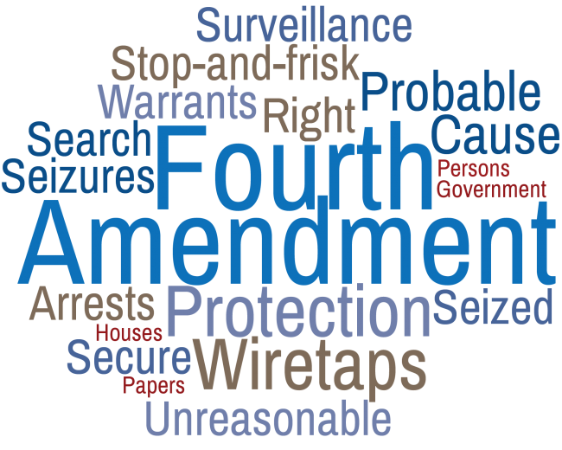
Social Media Policies
Search of employee technology
by public employers involves the
Fourth Amendment prohibition
against unreasonable searches
and seizures
Scope of Fourth Amendment protection generally comes down to reasonableness of the expectation of privacy, based on:
  Who provided or subsidized the device
  Whether there was notice given as to the possibility of searches
  How the expectation of privacy is presented
  in day-to-day dealings
Notes:
Fourth Amendment protections don’t apply to private employer’s right monitor employees’ use of workplace devices, and the policies for doing so should be documented
Key for public employees is creating a very limited expectation of privacy in employer owned devices.

Slide 26
Social Media Policies
In City of Ontario v. Quon, the Supreme Court found the city did not violate the Fourth Amendment rights of an employee police officer by reviewing his text messages sent and received by city-issued pagers.
  Does the employee have a reasonable expectation of privacy, considering the “operational realities of the workplace?”
  The employer's intrusion on that expectation for non-investigatory, work-related purposes, as well as for investigations of work-related misconduct, should be judged by the standard of reasonableness under all the circumstances.

Slide 27
Protected and Concerted Activity
National Labor Relations Act / Iowa Code Chapter 20
  Protects non-supervisory employees who engage in speech and concerted activities for their “mutual aid and protection”
  Protected activity involves discussions relating to wages, hours, and other terms and conditions of employment
  Concerted activity involves working with other employees for purposes of mutual aid and protection
  Concerted activity can occur on social media
Notes:
“terms and conditions of employment” can include workplace safety, company culture, employee leave, and working conditions
Exceptions to employer’s free discretion to legally limit politics in the workplace.
2.
Section 7 of the NLRA
-
“Employees shall have the right . . . to engage in other concerted activities for the purpose of collective bargaining or other mutual aid or protection.”
•
Non-supervisory employees have a right to discuss wages, hours and other terms and conditions of employment (“concerted activity”)
•
Protections extend to workplace conversations as well as those outside the workplace and outside working hours
•
Union and non-union employees

Slide 28
Analytical Framework
Does the speech relate to the terms and conditions of the employment?
Does the speech relate to a protected characteristic of the employee?
Is the anticipated action consistent with past action/company policies?

Slide 29
Off-Duty Conduct —
Public Employees
Fall back on enforcing existing policies, like prohibitions on harassment
  Employee retweets a tweet from a well-known white supremacist containing racial slurs
Focus more on impact on the workplace, not content of the expression
  The stronger the nexus to workplace effect, the more likely the speech can be regulated
If employee identifies themselves as an employee and the expression negatively reflects on the organization, can likely be disciplined
Notes:
Off duty political posts can still affect the workplace. It can create rifts among co-workers, imply endorsement of the employer, upset customers, or attract unwanted media attention

Slide 30
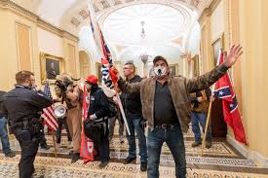
Off-Duty Conduct
Illegal activity is not protected
Those who committed illegal
acts at the U.S. Capitol could
be terminated.
  An employee at Navistar Direct Marketing of Fredrick, Maryland wore his work badge inside the Capitol and was fired.
  A real estate agent was fired by her brokerage firm for ascending the Capitol steps.
  A teacher in Pennsylvania was put on temporary leave while his participation is investigated.
Notes:
Illegal activity is not protected – take care the conduct is properly investigated
Those who committed illegal acts when at the U.S. Capital could be terminated, and some have been. For example:
https://www.reuters.com/article/us-usa-election-protests-fallout/some-us-capitol-rioters-fired-after-internet-detectives-identify-them-idUSKBN29C36M

Slide 31

Case Example
Starbucks initially prohibited employees from wearing Black Lives Matter paraphernalia at work but then changed position
Frith, et. al v. Whole Foods, 2020 WL 4059920 (July 20, 2020)
  Private employers generally have a lot of latitude to determine dress code
  Enforce any dress-code policies evenly and uniformly to prevent claims of discrimination on basis of a protected class
  If workers are wearing items to protest racially discriminatory practices specific to their workplace, they may have more protection
Notes:
Elizabeth Heffernan
Frith: 1:20-cv-11358 → Whole Foods and its parent company Amazon have publicly expressed support for Black Lives Matter, but have been disciplining employees for wearing BLM masks (when masks are required because of pandemic). The class action alleges that Whole Foods has not previously strictly enforced its dress code policy and has allowed employees to wear other messages, including political ones. Alleges discrimination based on race and unlawful retaliation. The case is still pending and there are motions to dismiss
If already made allowances for attire relating to other movements, but prohibit Black Lives Matter attire, there may be risk of race discrimination allegations
Massachusetts federal judge found on Feb. 5 that the workers failed to state a claim of discrimination because Title VII does not protect free speech in a private workplace, even though the policy wasn’t always enforced with regard to LBGT and other messaging. Even if they were selectively enforcing a dress code to suppress speech, the judge found it was not unlawful.
The workers are likely to appeal, on the grounds that the analysis for race discrimination was too narrow in light of the prevailing caselaw

Slide 32
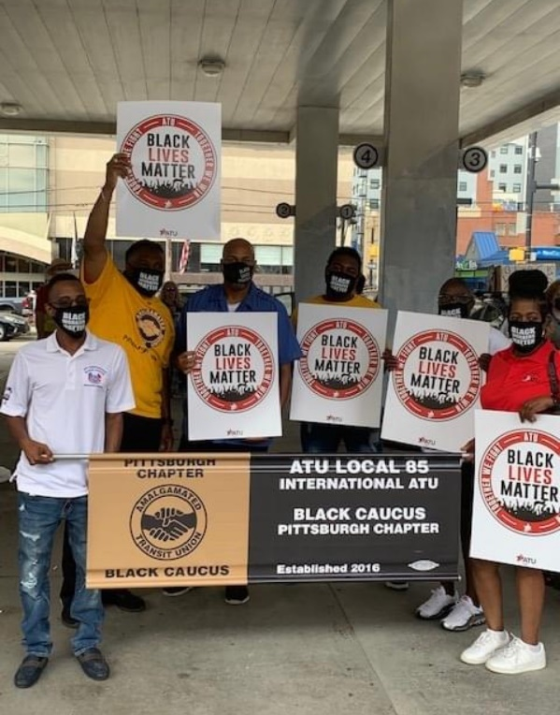
Case Example
Amalgamated Transit Union Local 85 v. Port Authority of Allegheny County, --F. Supp. 3d --, 2021 WL 164315 (W.D. Penn. Jan. 19, 2021)
            During COVID-19, employees are required to wear face masks. Several employees chose to wear masks with the “Black Lives Matter” slogan.

Slide 33
Case Example
The Port Authority had publicly endorsed the Black Lives Matter movement.
Port Authority had previously prohibited employees from wearing uniform adornments (i.e., buttons or stickers) reflecting political or social-protest messages.
One employee complained to management and asked how management would react if he wore a “White Lives Matter” mask.
Notes:
The Port Authority changed the policy because it had a strong interest in “heading off potential employee conflicts and customer-relations issues” in managing its workplace

Slide 34
Case Example
The Port authority extended the uniform policy to include face masks, and then required employees to wear one of a few specified masks.
Following the policy change, several employees were disciplined or threatened with discipline for wearing BLM masks.
Case not fully decided yet, but the court granted a preliminary injunction suspending the policy changes because the plaintiffs were likely to succeed on their First Amendment claim.
Notes:
where a government employer “restricts employee speech before it occurs, rather than penalizing employee speech after the fact,” the Court applies the modified Pickering analysis described in United States v. National Treasury Employees Union (“NTEU”), 513 U.S. 454, 115 S.Ct. 1003, 130 L.Ed.2d 964 (1995). Swartzwelder, 297 F.3d at 235. This differs from the ordinary Pickering test in that the government must make an even more difficult showing “that the interests of both potential audiences and a vast group of present and future employees in a broad range of present and future expression are outweighed by that expression's necessary impact on the operation of the government.” Swartzwelder, 297 F.3d at 236 (cleaned up). This is an “exacting standard.” Tucker v. State of Cal. Dep't of Educ., 97 F.3d 1204, 1211 (9th Cir. 1996).
Amalgamated Transit Union Local 85 v. Port Auth. of Allegheny Cty., No. 2:20-CV-1471-NR, 2021 WL 164315, at *12 (W.D. Pa. Jan. 19, 2021)
Slightly different than the test for penalizing/disciplining an employee because of past expression

Slide 35
Case Example
The speech at issue is of significant public concern.
The fact that it only applied to “on-duty” conduct was
not dispositive.
Port Authority failed to show evidence that allowing employees to wear BLM or equivalent masks was likely to disrupt the workplace. Allegations of disruption was not sufficient.
Notes:
At most, the Port Authority has identified (1) a few social-media messages or posts by Port Authority employees that can be viewed as reflecting debate about whether employees should be allowed to wear “Black Lives Matter” or “Thin Blue Line” masks;⁸ and (2) text messages reflecting (and a requested spoliation inference inferring) internal disagreement among Union members, either about the Union's support for “Black Lives Matter” and employees wearing “Black Lives Matters” masks generally, or about the Union's decision to litigate this particular case. See FOF, ¶¶ 36, 38-41.⁹
What is missing, however, is any evidence of complaints from bus riders or the public about drivers wearing certain masks; conflict or violence between employees or members of the public; impediments to employees performing their work; decreased employee efficiency; or any other negative impact in the workplace attributable to employees wearing masks that feature political or social-protest messages.
Amalgamated Transit Union Local 85 v. Port Auth. of Allegheny Cty., No. 2:20-CV-1471-NR, 2021 WL 164315, at *15 (W.D. Pa. Jan. 19, 2021)
the Port Authority is right to say that evidence of actual disruption is not necessarily required. See Munroe, 805 F.3d at 472. Under Pickering, a government-employer's reasonable prediction of “likely” disruption can be enough, so long as the feared disruption is significant enough to overcome the employee's expressive interests. Id. But the lack of any evidence of actual disruption is nonetheless telling here, given the ample opportunity for such disruption to occur in connection with (1) several months of drivers wearing masks with political and social-protest messages, FOF, ¶¶ 15-18; (2) Port Authority drivers routinely wearing political buttons and other adornments with such messages for many years (despite the policy against it), FOF, ¶¶ 9, 10; and (3) the Port Authority's own political and social-issue messaging; for example, its public pronouncements that support “Black Lives Matter” or the political and social-issue messages that are placed on its buses—which are often far more prominent than a message on a mask or button
Amalgamated Transit Union Local 85 v. Port Auth. of Allegheny Cty., No. 2:20-CV-1471-NR, 2021 WL 164315, at *16 (W.D. Pa. Jan. 19, 2021)

Slide 36

Case Example
Heller v. Bedford Central Sch. Dist., 665 Fed. Appx. 49 (2d Cir. 2016)
  Former public school teacher had multiple conversations online during which he stated he believed aliens controlled the government, the Sandy Hook school shooting was faked, and he wanted to “kill people.”
  He claimed the statements were “off-the-cuff political hyperbole written in the context of friendly social media banter.”
  The court found there was no violation of the First Amendment because his communications presented a substantial risk of disruption that justified the school district’s actions to terminate him.

Slide 37
(1) First Amendment Violation?
Employee was a prosecuting attorney handling a criminal case in court. A defense attorney in the case claimed a search warrant was based on an inaccurate affidavit. Employee investigation disclosed serious misrepresentations in the affidavit. Employee reported his findings to his supervisors and recommended the dismissal of the case.
Thereafter, employee was reassigned to a different position, reassigned to a different courthouse, and passed up for a promotion.
Notes:
His superiors decided to continue prosecuting the case and criticized the employee for his handling of the matter. He was then reassigned.

Slide 38

(1) First Amendment Violation?
No Violation
Court found that the First Amendment does not prevent employees from being disciplined for expressions they make pursuant to their professional duties.
Garcetti v. Ceballos, 547 U.S. 410 (2006).
Notes:
He is a public employee, but because he was not speaking as a citizen on a matter of public concern
On the other hand, there was a recent case out of Florida pertained to an assistant county public defender who ran against the incumbent, her boss. Her boss fired her the morning after election day. The court decided that she had alleged sufficient facts to establish a possible First Amendment claim because the campaigning was not part of her duties as a public defender and her social justice advocacy were matters of public concern. The defendants failed to explain the nature of her “unprofessional conduct” for which she was allegedly fired.
Green v. Finkelstein, S.D. Fla., No. 0:20-cv-62160, 2/4/21

Slide 39

(2) First Amendment Violation?
A Dean of Students posted an ad on Craigslist titled “Horned up all weekend and need release,” where he was soliciting sex. The posting contained pictures of his face, torso, genitalia, and anus, as well as obscene written text.
The posting was discovered by a parent and reported to the District.
Notes:
The posting contained the following text:
“In shape guy, masc, attractive, 32 waist, swimmer's build, horny as fuck. Looking to suck and swallow masc guys, also looking to get fucked. Uncut and huge shooters jump to head of line. Give my [sic ] your loads so I can shoot mine. White, black, Hispanic, European, all good. No fats, fems, queens, asians. NO BELLIES. Have pics when you email.”
He was placed on administrative leave and served with a notice of suspension and intent to dismiss.

Slide 40
(2) First Amendment Violation?
No Violation
The Court found that the employee’s conduct was “detrimental to the mission and functions of [his] employer.”
Interestingly, this decision was only after a prior ruling found employee’s rights had been violated and ordered the school district to return the Dean of Students to employment.
San Diego Unif. Sch. Dist. v. Comm. on Prof. Competence, 194 Cal.App.4th 1454 (2011)
Notes:
“a parent and an educator did see the ad. The parent who complained viewed the ad and even walked the police dispatcher through the Web site to show her how to view the ad. Principal Levy also viewed the ad. Principal Levy testified that based upon Lampedusa's conduct she had lost confidence in Lampedusa's ability to serve as a role model for students. This evidence is substantial evidence of an adverse impact on Lampedusa's on-campus relationships”

Slide 41
(3) First Amendment Violation?
Former police officer spoke to the alderman after a city council meeting about complaints from citizens regarding the enforcement of the city’s DUI laws, which had not been previously enforced.
  He stated: “All I’m trying to do out here is do my job.”
  He also spoke to the newly-elected mayor about the importance of DUI laws and “sacrificing people’s safety for political reasons was not an option.”
  The officer was subsequently laid off pursuant to a city council vote.
Notes:
The mayor had told the officer that the bars make the city a lot of money and everyone needed to be kept happy, but strict enforcement of the DUI laws making that difficult

Slide 42

(3) First Amendment Violation?
Yes – Court found a violation because:
Employee was speaking as a private citizen
Employee’s speech was a matter of public concern
Employee’s interest outweighed the interests of the employer
  No evidence his statements impacted other officers’ abilities to do their job (even if they didn’t enforce the DUI laws as strenuously)
  His statements were made to individuals outside the police department.
Willoby v. Mason City, Ill., 449 F. Supp. Ed 806 (C.D. Ill, March 27, 2020)
Notes:
Duties as a police officer did not include meeting with elected officials about the need to enforce DUI laws to keep the public safe. The controlling factor was whether the speech “owed its existence” to an employee’s professional responsibilities
Speech was an attempt to protect the public by ensuring DUI laws would be enforced (bring about change with public ramifications)

Slide 43


“Likes” and the First Amendment
Can you be fired for “liking” a Facebook post?

Slide 44

(4) First Amendment Violation?
During the course of an election for sheriff,
four deputy sheriffs and two non-uniformed civilian employees with the sheriff’s department “Liked” a Facebook page relating to the campaign of a challenger running against the incumbent sheriff.
After the current sheriff was re-elected, the sheriff immediately fired the employees.

Slide 45
(4) First Amendment Violation?
Yes – Court found a violation because:
Employee positions were not so entwined with policy that they could be terminated for disloyalty to the Sheriff.
Their speech was made in their private capacities and related to matters of public concern.
There was no evidence of disruption to the workplace as a result of their speech.
Bland v. Roberts, 730 F.3d 368 (4th Cir. 2013)

Slide 46



Q & A Time
Ahlers & Cooney, P.C.
Aaron Hilligas - ahilligas@ahlerslaw.com
Ann Smisek - asmisek@ahlerslaw.com
Notes:
Point out the LinkedIn and Facebook symbols here – be sure to FOLLOW us on LinkedIn and Facebook.

Slide 47
Thank You!

