Slide 1



Unplanned Work:
How it Keeps You From Your Goals
Presented by
Joseph Heieck
President & CEO, gWorks
Iowa League of Cities 2021 Annual Conference

Slide 2





Who is gWorks
Purpose
Vision
Mission
Empower public leaders to build smarter, more sustainable governments and stronger, more resilient communities with simple technologies and solutions.
Power thousands of small local governments with an easy-to-use and integrated software suite that connects data, people, and effective action into community strength and pride.
Cultivate the strongest and smartest team who delivers the simplest, most effective, & most pleasing technology solutions to small local governments and who backs it up with the best support in the industry.
Smarter Government | Stronger Communities | Simpler Solutions

Slide 3








LocalGovOS
40+ Cloud and Desktop Solutions
SimpleCity
FrontDesk
Physical Asset Management
GIS
Purchase Orders
Cemetery Management
Billing & Licensing
Utility Billing
Smarter Government | Stronger Communities | Simpler Solutions

Slide 4
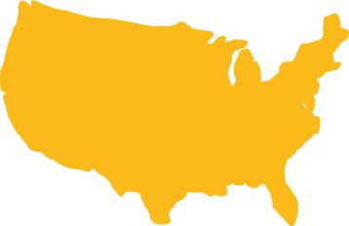
We're Committed to Client Success
99%
98%
1,150
28
Clients
States
Client Satisfaction
Client Retention
50%
Nearly of Iowa cities use gWorks software
Smarter Government | Stronger Communities | Simpler Solutions

Slide 5



Three Types of Work
Business
Internal
Unplanned
Smarter Government | Stronger Communities | Simpler Solutions

Slide 6






Business Work
Anything the city does that provides value to its customers
Includes
Capital Projects
Providing
Utilities
Offering Online
Bill Payments
Maintaining Parks
Smarter Government | Stronger Communities | Simpler Solutions

Slide 7





Internal Work
Workflows and systems for delivering the business work in an efficient, cost-effective manner
Example: To repair a street you need to…..
Create a work schedule
Source the right equipment
Assess how much labor you need
Smarter Government | Stronger Communities | Simpler Solutions

Slide 8




Unplanned Work
What is Unplanned Work?
Issues, incidents, or problems that arise at importune times
It inhibits both business and internal work
Smarter Government | Stronger Communities | Simpler Solutions

Slide 9
Questions to Ask Yourselves
1
How hard does it become to get your essential work done?
2
If you have a deadline, what kind of stress does this disruption cause you?
3
Ever worked late or come in on the weekend to “catch up” due to unplanned work?
4
Can you rid yourself of unplanned work?
Smarter Government | Stronger Communities | Simpler Solutions

Slide 10



Three Ways to Conquer Unplanned Work
Plan for it
Create
Your Lanes
Modern
Technology
Smarter Government | Stronger Communities | Simpler Solutions

Slide 11
Plan For It
Block time in your schedule for both planned and unplanned work. Then stick to it.
8:00
9:00
10:00
11:00
12:00
1:00
2:00
3:00
4:00
5:00
Smarter Government | Stronger Communities | Simpler Solutions

Slide 12


Create Your Lanes
Creating lanes is the most effective method for overcoming the impact of unplanned work
Inbound-Unplanned Work
Outbound-Planned Work
-It can be tough for small communities
-Use a rotational schedule
Smarter Government | Stronger Communities | Simpler Solutions

Slide 13


Modern Technology
Automates or lifts the burden of unplanned work
Simple Solutions
Do customer calls repeat the same questions?
Create chatbot, Add FAQ section to your website
Self-Serve Options
Do you have a website? Does it offer self-serve options?
Allow your customers to serve themselves
Smarter Government | Stronger Communities | Simpler Solutions

Slide 14
What To Do Going Forward
1
Take time to identify what’s causing your unplanned work
2
Conduct Root Cause Analysis
3
Once you know it, address it with solutions
Smarter Government | Stronger Communities | Simpler Solutions

Slide 15
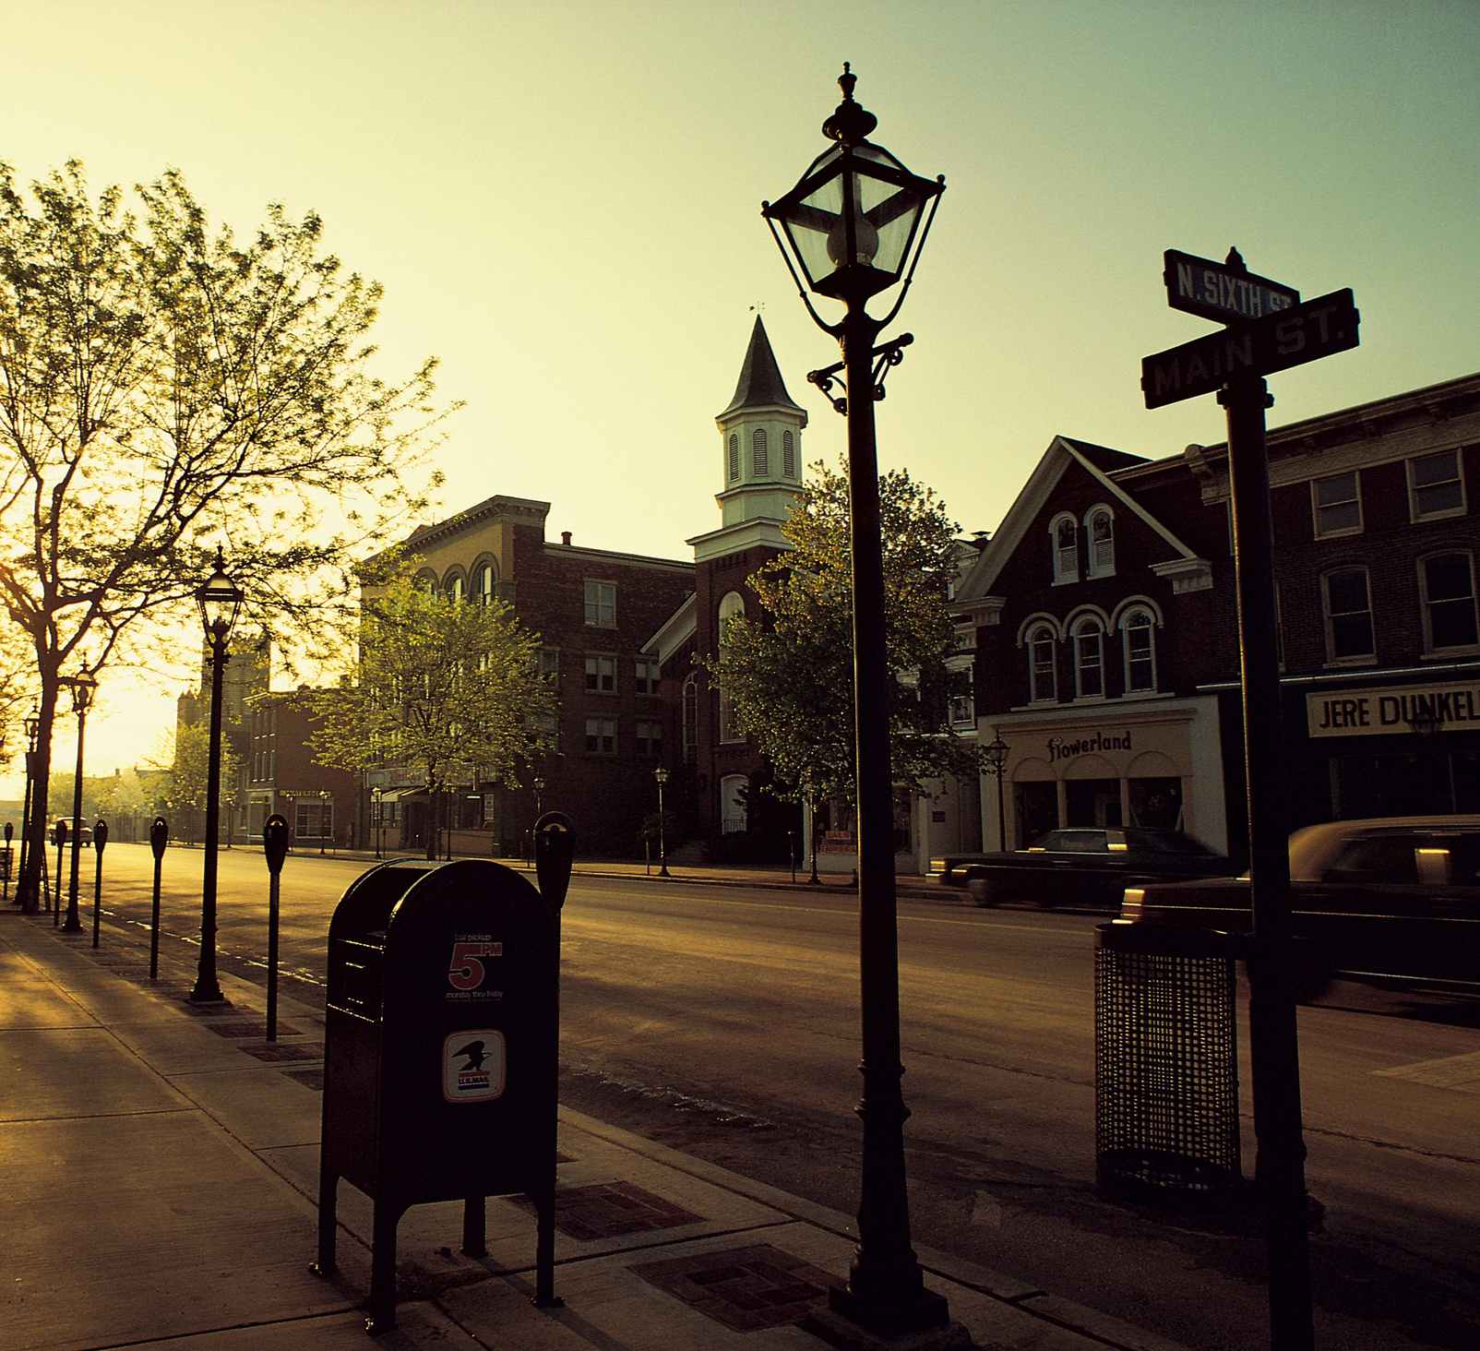
Questions
Smarter Government | Stronger Communities | Simpler Solutions

Slide 16




Thank You!
www.gworks.com
(888) 608-7666
info@gworks.com
3905 South 148th Street, Ste 200
Omaha, NE 68144
Smarter Government | Stronger Communities | Simpler Solutions

